Slide 1
CSC230
AVL Tree

Slide 2
Tree has a problem
12
22
8
22
8
23
3
9
15
23
5
9
1
7
13
18
4
7
3
✔
1
✗
Worst case: O(log n)
0
2
Worst case: O(n)
Notes:
A B C D E F G H I J K L M N O P Q R S T U V W X Y Z
0 1 2 3 4 5 6 7 8 9 10 11 12 13 14 15 16 17 18 19 20 21 22 23 24 25

Slide 3
What do we want?
 | Lookup | Insertion | Deletion
Worst case | O(log n) | O(log n) | O(log n)
Average case | O(log n) | O(log n) | O(log n)

Slide 4
AVL tree
Invented by Georgy Adelson-Velsky and Evgenii Landis (AVL) in 1962
It is a self-balancing binary search tree
Lookup, insertion, and deletion can be done in O(log n) under both average and worst cases. n is the number of nodes in the tree
The heights of two child subtrees of any given node diff by at most one
Any node of AVL tree
h-2
h
α
h-1
β

Slide 5
AVL tree
The heights of two child subtrees of any given node diff by at most one
12
12
6
22
6
22
3
9
15
23
3
9
1
7
13
18
1
7
✔
✗

Slide 6
Searching/Lookup is trivial
AVL is a special binary search tree
Searching a key in an AVL tree is the same way as that of a normal binary search tree

Slide 7
Traversal
Suppose that you already found the key in the AVL tree
You want to find the “previous” or “next” key value in the AVL tree
β
Key that we searched for
“previous” Key
α
γ
“next” Key
Best-case time complexity: O(1)

Slide 8
Traversal
Suppose that you already found the key in the AVL tree
You want to find the “previous” or “next” key value in the AVL tree
12
Key that we searched for
6
22
3
9
15
23
1
7
13
18
“previous” Key
“next” Key
worst-case time complexity: O(log n)

Slide 9
Single rotations
Rotate right
α
Rotate left
γ
β
γ
α
β

Slide 10
Double Rotation
θ
α
α
β
γ
θ
β
γ
Left sub-tree is two levels deeper than the right sub-tree
Move yellow node up two levels and red node one level down

Slide 11
Overview of Insertion and Deletion
It is performed as in binary search tree
If the balance is destroyed, rotation(s) is performed to correct balance
One rotation is sufficient for one insertion
For one deletion, O(log n) rotations at most

Slide 12
AVL Insertion
When insert a new node to the AVL, pretend that you are searching the node in the tree. Insert the new node to the place where searching falls off the tree (just like what we did in the lab)
After an insertion, only the nodes that on the path from the inserted node to the root can have altered balance
If the inserted AVL tree is out of balance (given a node, the heights of its two subtrees differ by more than 1), rebalance the AVL (by rotation).

Slide 13
Rebalancing for insertion
Suppose the node to be rebalanced is x, there are four possible scenarios (two of them are symmetric to the other two)
An insertion in the left subtree of the left child of X,
An insertion in the right subtree of the left child of X,
An insertion in the left subtree of the right child of X, or
An insertion in the right subtree of the right child of X.
x
Left left case
x
Left right case
x
Right left case
x
Right right case

Slide 14
How to rebalance? Rotation
Case 1 (left left case) and case 4 (right right case) are symmetric and requires the same operation for balance.
Cases 1,4 are handled by single rotation.
Case 2 (left right case) and case 3 (right left case) are symmetric and requires the same operation for balance.
Cases 2,3 are handled by double rotation.

Slide 15
Single rotation
Rotate right
γ
α
β
β
γ
α

Slide 16
Analysis
After one node insertion, if we have case 1 or 4.
One single rotation can fix it
The new height of the rotated subtree is the same as that of the subtree before insertion
When imbalance exists, find the first node from the inserted node to the root that it is out of balance
Single rotation take time O(1)
Insertion takes time O(log n)

Slide 17
Case 2 and Case 3
Single rotation does not fix case 2 and case 3.
They can be fixed by double rotation

Slide 18
Single Rotation does not work for case 2 and case 3
Rotate right
γ
α
γ
α
β
β

Slide 19
Double Rotation
θ
α
α
β
γ
θ
β
γ
Left sub-tree is two levels deeper than the right sub-tree
Move yellow node up two levels and red node one level down

Slide 20
Double Rotation – in slow motion
double rotation can be viewed as two single rotations
Example: case 2
Rotate left
θ
θ
α
γ
Rotate right
β
γ
α
β
α
β
γ
θ

Slide 21
AVL Tree Rotations
Single rotations: insert 14, 15, 16, 13, 12, 11, 10
First insert 14 and 15:
14
15
Now insert 16.

Slide 22
AVL Tree Rotations
Single rotations:
Inserting 16 causes AVL violation:
14
15
16
Need to rotate.

Slide 23
AVL Tree Rotations
Single rotations:
Inserting 16 causes AVL violation:
14
15
16
Need to rotate.

Slide 24
AVL Tree Rotations
Single rotations:
Rotation type:
14
15
16

Slide 25
AVL Tree Rotations
Single rotations:
Rotation restores AVL balance:
15
14
16

Slide 26
AVL Tree Rotations
Single rotations:
Now insert 13 and 12:
15
14
16
13
12
AVL violation - need to rotate.

Slide 27
AVL Tree Rotations
Single rotations:
Rotation type:
15
14
16
13
12

Slide 28
AVL Tree Rotations
Single rotations:
15
13
16
12
14
Now insert 11.

Slide 29
AVL Tree Rotations
Single rotations:
15
13
16
12
14
11
AVL violation – need to rotate

Slide 30
AVL Tree Rotations
Single rotations:
Rotation type:
15
13
16
12
14
11

Slide 31
AVL Tree Rotations
Single rotations:
13
12
15
14
16
11
Now insert 10.

Slide 32
AVL Tree Rotations
Single rotations:
13
12
15
14
16
11
10
AVL violation – need to rotate

Slide 33
AVL Tree Rotations
Single rotations:
Rotation type:
13
12
15
14
16
11
10

Slide 34
AVL Tree Rotations
Single rotations:
13
11
15
10
12
14
16
AVL balance restored.

Slide 35
AVL Tree Rotations
Double rotations: insert 1, 2, 3, 4, 5, 7, 6, 9, 8
First insert 1 and 2:
13
11
15
10
12
14
16

Slide 36
AVL Tree Rotations
Double rotations:
AVL violation - rotate
13
11
15
14
16
10
12
1
2

Slide 37
AVL Tree Rotations
Double rotations:
Rotation type:
13
11
15
14
16
10
12
1
2

Slide 38
AVL Tree Rotations
Double rotations:
AVL balance restored:
13
11
15
2
12
14
16
1
10
Now insert 3.

Slide 39
AVL Tree Rotations
Double rotations:
AVL violation – rotate:
13
11
15
2
12
14
16
1
10
3

Slide 40
AVL Tree Rotations
Double rotations:
Rotation type:
13
11
15
2
12
14
16
1
10
3

Slide 41
AVL Tree Rotations
Double rotations:
AVL balance restored:
13
10
15
2
11
14
16
1
3
12
Now insert 4.

Slide 42
AVL Tree Rotations
Double rotations:
AVL violation - rotate
13
10
15
2
11
14
16
1
3
12
4

Slide 43
AVL Tree Rotations
Single rotations:
Rotation type:
13
10
15
2
11
14
16
1
3
12
4

Slide 44
AVL Tree Rotations
Single rotations:
10
2
13
1
3
11
15
4
12
14
16
Now insert 5.

Slide 45
AVL Tree Rotations
Double rotations:
10
2
13
1
3
11
15
4
12
14
16
5
AVL violation – rotate.

Slide 46
AVL Tree Rotations
Single rotations:
Rotation type:
10
2
13
1
3
11
15
4
12
14
16
5

Slide 47
AVL Tree Rotations
Single rotations:
AVL balance restored:
10
2
13
1
4
11
15
3
5
12
14
16
Now insert 7.

Slide 48
AVL Tree Rotations
Single rotations:
AVL violation – rotate.
10
2
13
1
4
11
15
3
5
12
14
16
7

Slide 49
AVL Tree Rotations
Single rotations:
Rotation type:
10
2
13
1
4
11
15
3
5
12
14
16
7

Slide 50
AVL Tree Rotations
Double rotations:
AVL balance restored.
10
4
13
2
5
11
15
7
12
14
16
1
3
Now insert 6.

Slide 51
AVL Tree Rotations
Double rotations:
AVL violation - rotate.
10
4
13
2
5
11
15
7
12
14
16
1
3
6

Slide 52
AVL Tree Rotations
Double rotations:
Rotation type:
10
4
13
2
5
11
15
7
12
14
16
1
3
6

Slide 53
AVL Tree Rotations
Double rotations:
AVL balance restored.
10
4
13
2
6
11
15
12
14
16
1
3
5
7
Now insert 9 and 8.

Slide 54
AVL Tree Rotations
Double rotations:
AVL violation - rotate.
10
4
13
2
6
11
15
12
14
16
1
3
5
7
9
8

Slide 55
AVL Tree Rotations
Double rotations:
Rotation type:
10
4
13
2
6
11
15
12
14
16
1
3
5
7
9
8

Slide 56
AVL Tree Rotations
Final tree:
Tree is almost perfectly balanced
10
4
13
2
6
11
15
12
14
16
1
3
5
8
7
9

Slide 57
Deletion
Insertion needs at most one rebalancing
Deletion may take multiple (O(log n)) rebalancing
After one rebalance, it cause other ancestral nodes out of balance

Slide 58
Deletion
If the node is a leaf or has ONLY ONE child subtree, remove it.
Retrace back up the tree starting with the parent of deleted node to the root, adjusting the balance factor as needed.
If it’s has TWO child subtrees, replace it with the largest in its left subtree and remove that node.
You could also replace with the smallest in its right subtree
After deletion, retrace the path back up the tree, starting with the parent of the replacement, to the root, adjusting the balance factor as needed.

Slide 59
Delete a leaf
32
Action position
16
48
8
24
40
56
Node to be deleted
28
36
44
52
60
58
62

Slide 60
Delete a leaf, cont’d
32
Balance factor = -2
16
48
24
40
56
28
36
44
52
60
58
62

Slide 61
Delete a leaf, cont’d
Balance factor = -2
32
32
Balance factor = -1
24
48
48
16
16
28
40
56
56
36
44
52
60
58
62

Slide 62
Delete a leaf, cont’d
48
32
56
24
40
52
60
16
58
62
16
28
36
44

Slide 63
Delete a node with ONLY one child
32
Action position
16
48
8
24
40
56
Node to be deleted
28
36
44
52
60
58
62

Slide 64
Delete a node with ONLY one child, cont’d
32
Action position
16
48
✗
8
24
40
56
28
36
44
52
60
58
62

Slide 65
Delete a node with ONLY one child, cont’d
32
Balance factor = 0
16
48
8
28
40
56
36
44
52
60
58
62

Slide 66
Delete a node with ONLY one child, cont’d
Balance factor = -2
32
Balance factor = -1
16
48
8
28
40
56
36
44
52
60
58
62

Slide 67
Delete a node with ONLY one child, cont’d
48
32
56
16
40
52
60
16
58
62
8
28
36
44

Slide 68
Delete a node with two child subtrees
Node to be deleted
32
16
48
8
24
40
56
28
36
44
52
60
The largest value of left subtree
58
62

Slide 69
Delete a node with two child subtrees
Node to be deleted
32
16
48
8
24
40
56
✗
28
36
44
52
60
Actcion position
The largest value of left subtree
58
62

Slide 70
Delete a node with two child subtrees
Node replaced
28
16
48
8
24
40
56
36
44
52
60
Actcion position
58
62

Slide 71
Delete a node with two child subtrees
Balance factor =-2
28
Balance factor =0
16
48
Balance factor =0
8
24
40
56
36
44
52
60
58
62

Slide 72
Delete a node with two child subtrees
Balance factor =-2
28
Balance factor = -1
16
48
8
24
40
56
36
44
52
60
58
62

Slide 73
Delete a node with two child subtrees
48
28
56
16
40
52
60
16
58
62
8
24
36
44

Slide 74
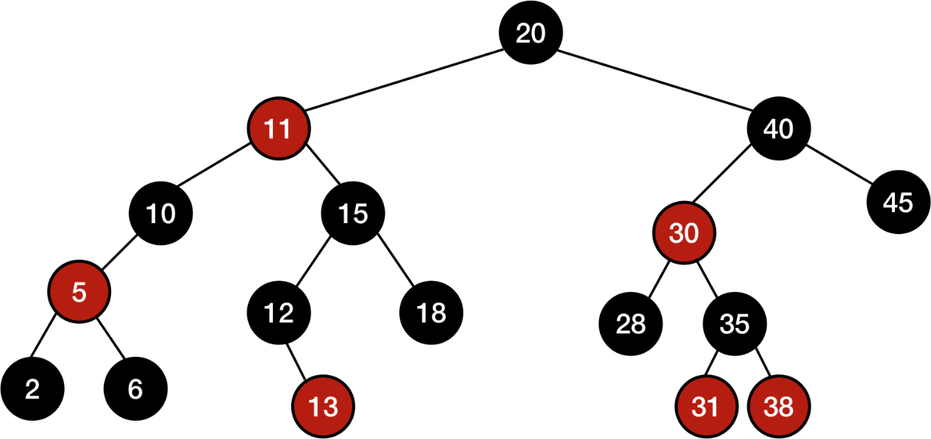
Red-black tree
Every node is colored either red or black.
The root node is black.
A red node's children cannot be red.
A null child is considered to be a black leaf node.
All paths from a node to any null leaf descendant node must have the same number of black nodes.

Slide 75
Red-black tree rotation
Same as AVL rotation

Slide 76
Red-black tree insertion
Assign parent with node's parent, uncle with node's uncle, which is a sibling of parent, and grandparent with node's grandparent.
If node is the tree's root, then color node black and return.
If parent is black, then return without any alterations.
If parent and uncle are both red, then color parent and uncle black, color grandparent red, recursively balance grandparent, then return.
If node is parent's right child and parent is grandparent's left child, then rotate left at parent, update node and parent to point to parent and grandparent, respectively, and goto step 7.
If node is parent's left child and parent is grandparent's right child, then rotate right at parent, update node and parent to point to parent and grandparent, respectively, and goto step 7.
Color parent black and grandparent red.
If node is parent's left child, then rotate right at grandparent, otherwise rotate left at grandparent.

Slide 77
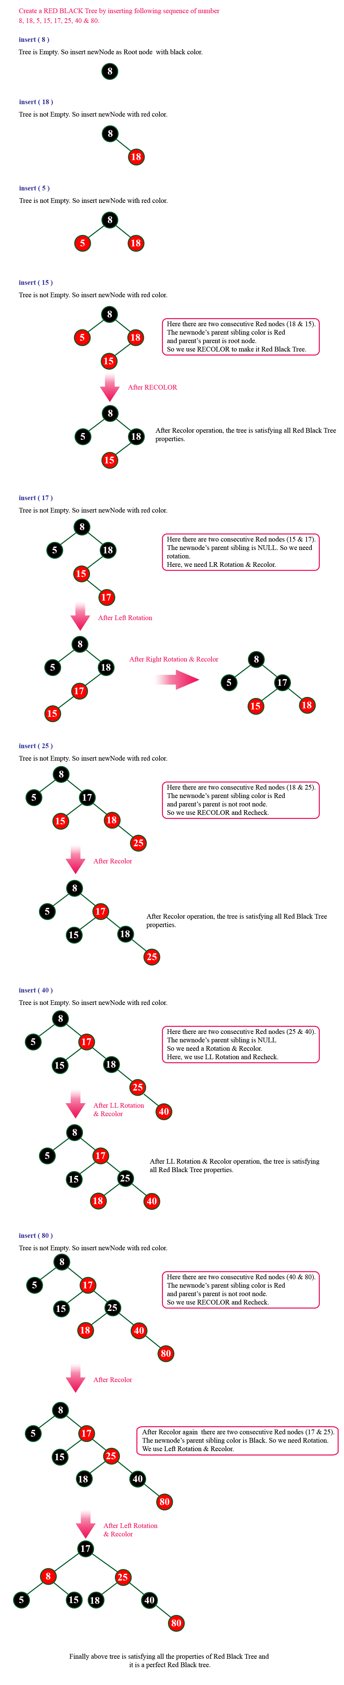
Red-black tree insertion

Slide 78
Red-black tree insertion

Slide 79
Red-black tree insertion

Slide 80
Red-black tree insertion

Slide 81
Red-black tree insertion

Slide 82
Red-black tree insertion

